Slide 1


Domingo Jesús Sánchez Blanco
16/01/2025

Slide 2

Outline
Executive Summary
Introduction
Methodology
Results
Conclusion
Appendix

Slide 3
Executive Summary
Summary of methodologies
Data collection and wrangling
Exploratory Data Analysis with Data Visualization and SQL
Building an interactive map and Dashboard
Predictive analysis
Summary of all results
Exploratory Data Analysis results
Interactive analytics demo in screenshots
Predictive analysis results

Slide 4
Introduction
Project background and context
The commercial space industry is rapidly advancing, with companies like Virgin Galactic offering suborbital flights, Rocket Lab focusing on small satellites, and Blue Origin developing reusable rockets. SpaceX, the industry leader, has achieved significant milestones such as sending spacecraft to the International Space Station, launching Starlink for satellite internet, and conducting manned missions. SpaceX’s ability to reduce launch costs—$62 million for a Falcon 9 launch—stems from reusing the rocket's first stage, unlike competitors who charge much more. In this project, you will act as a data scientist for Space Y, a new company founded by billionaire Allon Musk, aiming to compete with SpaceX. Your role involves analyzing SpaceX’s operations to determine launch costs and predicting whether SpaceX will reuse the Falcon 9's first stage using machine learning models and publicly available data.
Problems you want to find answers
How do variables like payload mass, launch site, number of flight, and orbits influence the success of the first stage landing?
Has the rate of successful landings improved over the years?
What is the most effective algorithm for classification in this scenario?

Slide 5

Section 1

Slide 6
Methodology
Executive Summary
Data collection methodology:
Using SpaceX API Rest and Web Scraping
Perform data wrangling
The process involve filtering the data and handling missing values to prepare the data for classification
Perform exploratory data analysis (EDA) using visualization and SQL
Perform interactive visual analytics using Folium and Plotly Dash
Perform predictive analysis using classification models
Developing, optimizing, and assessing classification models to achieve the best result

Slide 7
Data Collection
The data collection process combined API requests from SpaceX API Rest and the use of web scraping. Both methods were necessary to gather comprehensive information about the launches.

Slide 8
Data Collection – SpaceX API
Flowchart of SpaceX API calls
Import Libraries and Define Auxyliary Functions
Request and parse the SpaceX launch data using the GET request.
Decode the response content as Json
Turn it into a Pandas dataframe
Get information using Ids given for each launch.
Dealing with Missing Values
Data Wrangling
Filter the dataframe to onmly include Falcon 9 launches
Construct our dataset using the data we have obtained
Apply functions to get the data
Lab 1: Collecting the data

Slide 9
Data Collection - Scraping
Perform an HTTP GET method to request the Falcon9 Launch HTML page, as an HTTP response.
Create a BeautifulSoup object from the HTML response
Print the page title to verify if the `BeautifulSoup` object was created properly
Create a data frame by parsing the launch HTML tables
Create a data frame by parsing the launch HTML tables
Extract all column/variable names from the HTML table header
Web scraping notebook

Slide 10
Data Wrangling
In this section, we performed some Exploratory Data Analysis (EDA) to find some patterns in the data and determine what would be the label for training supervised models.
Flow:
GitHub URL of data wrangling notebooks
Load Space X dataset, from last section
Identify and calculate the percentage of the missing values in each attribute
Identify which columns are numerical and categorical
Calculate the number of launches on each site
Create a landing outcome label from Outcome column
Calculate the number and occurence of mission outcome of the orbits
Calculate the number and occurrence of each orbit

Slide 11
EDA with Data Visualization
Charts were plotted:
Visualize the relationship between Flight Number and Launch Site
Visualize the relationship between Payload and Launch Site
Visualize the relationship between success rate of each orbit type
Visualize the relationship between FlightNumber and Orbit type
Visualize the relationship between Payload and Orbit type
Visualize the launch success yearly trend
GitHub URL of EDA with data visualization notebook.

Slide 12
EDA with SQL
Performed SQL queries:
Display the names of the unique launch sites in the space mission
Display 5 records where launch sites begin with the string 'CCA'
Display the total payload mass carried by boosters launched by NASA (CRS)
Display average payload mass carried by booster version F9 v1.1
List the date when the first succesful landing outcome in ground pad was acheived.
List the names of the boosters which have success in drone ship and have payload mass greater than 4000 but less than 6000
List the total number of successful and failure mission outcomes
List the names of the booster_versions which have carried the maximum payload mass using a subquery
List the records which will display the month names, failure landing_outcomes in drone ship ,booster versions, launch_site for the months in year 2015.
Rank the count of landing outcomes (such as Failure (drone ship) or Success (ground pad)) between the date 2010-06-04 and 2017-03-20, in descending order.
GitHub URL of EDA with SQL notebook

Slide 13
Build an Interactive Map with Folium
Map objects created and added to a folium map:
All launch sites on a map
The success/failed launches for each site on the map
Calculate the distances between a launch site to its proximities
The reason to mark this points in the mark was to be able ro find some geographical patterns about launch sites
GitHub URL of the interactive map with Folium

Slide 14
Build a Dashboard with Plotly Dash
Plots/graphs and interactions you have added to a dashboard
A Launch Site Drop-down Input Component
A callback function to render success-pi-chart based on selected site dropdown
A Range Slider to select Payload
A callback function to render success-payload-scatter-chart
This dashboard application contains input components such as a dropdown list and a range slider to interact with a pie chart and a scatter point chart.
After visual analysis using the dashboard, you should be able to obtain some insights to answer the following five questions:
Which site has the largest successful launches? Which site has the highest launch success rate? Which payload range(s) has the highest launch success rate? Which payload range(s) has the lowest launch success rate? Which F9 Booster version (v1.0, v1.1, FT, B4, B5, etc.) has the highest launch success rate?
GitHub URL of the Plotly Dash lab

Slide 15
Predictive Analysis (Classification)
GitHub URL of the predictive analysis lab
Create a NumPy array from the column Class in data
Standardize the data
Split the data X and Y into training and test data
Create a logistic regression object
and a GridSearchCV
Fit the object to find the best parameters from the dictionary parameters
Create a Decision tree object and a GridSearchCV
Calculate the accuracy on the test data using the method score
Fit the object to find the best parameters from the dictionary parameters
Create a SVM object
and a GridSearchCV
Calculate the accuracy on the test data using the method score
Fit the object to find the best parameters from the dictionary parameters
Calculate the accuracy on the test data using the method score
Create a KNN object and a GridSearchCV
Fit the object to find the best parameters from the dictionary parameters
Calculate the accuracy on the test data using the method score
Find the method perform best

Slide 16
Results
Exploratory data analysis results
Interactive analytics demo in screenshots
Predictive analysis results

Slide 17

Section 2

Slide 18
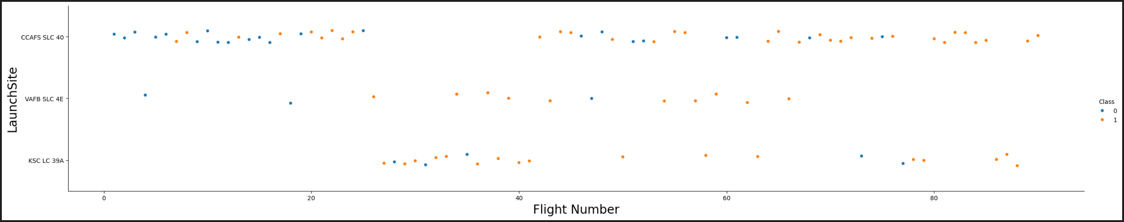
Flight Number vs. Launch Site
Scatter plot of Flight Number vs. Launch Site
Explanations:
The CCAFS SLC 40 launch site has about a half of all launches
VAFB SLC 4E and KSC LC 39AHave the higher success rates

Slide 19
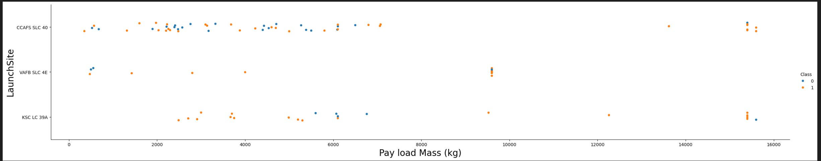
Payload vs. Launch Site
Scatter plot of Payload vs. Launch Site
Explanations:
Most of the launches with payload mass over 7000 kg were successful
KSC LC 39A has a 100% success rate for payload mass under 5000 kg

Slide 20
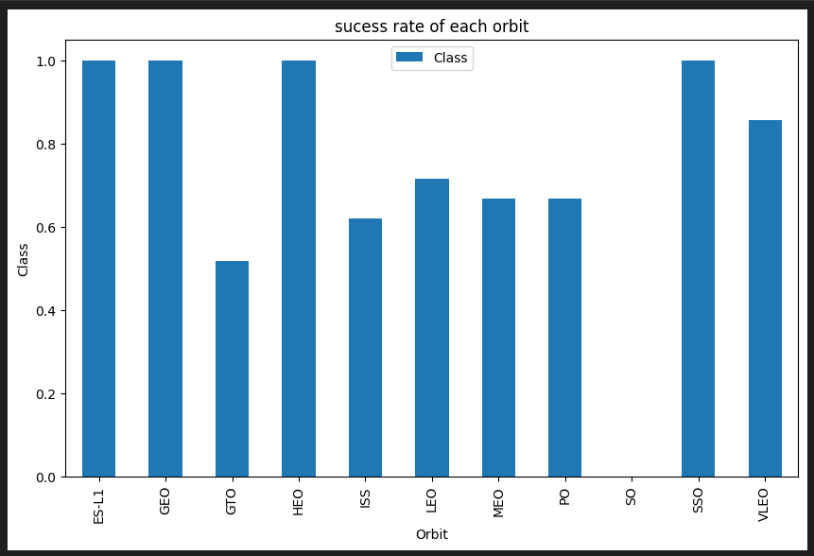
Success Rate vs. Orbit Type
Bar chart for the success rate of each orbit type
Explanations:
We have 4 orbits with a 100% success rate:
ES-L1, GEO, HEO, SSO
The orbit SO has a 0% success rate.
The rest of the orbits have a success rate between 50-85%

Slide 21
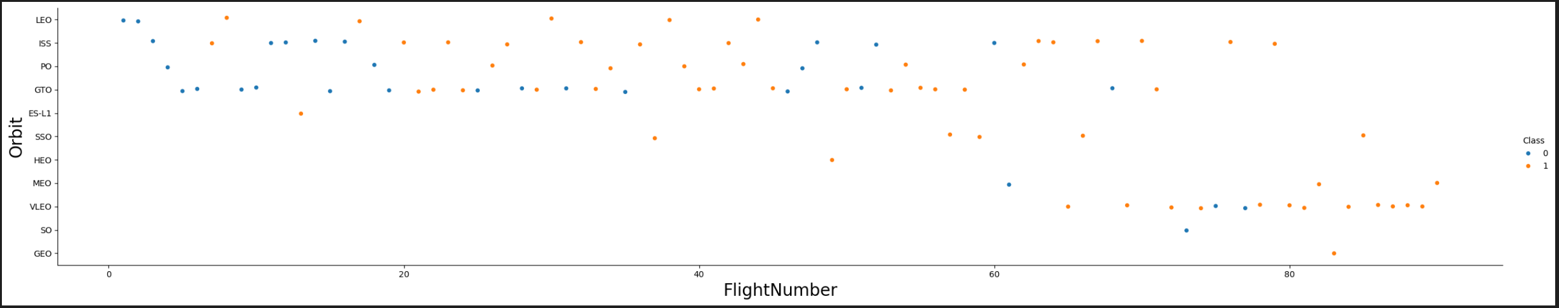
Flight Number vs. Orbit Type
Show a scatter point of Flight number vs. Orbit type
Explanations:
In the LEO orbit, success appears to be linked to the number of flights, whereas no clear relationship is observed between flight number and success for the rest orbits

Slide 22
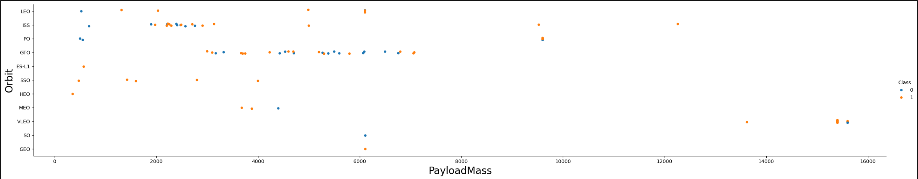
Payload vs. Orbit Type
Scatter point of payload vs. orbit type
Explanations:
With heavy payloads the successful landing or positive landing rate are more for PO, LEO and ISS.
However, for GTO, it's difficult to distinguish between successful and unsuccessful landings as both outcomes are present.

Slide 23
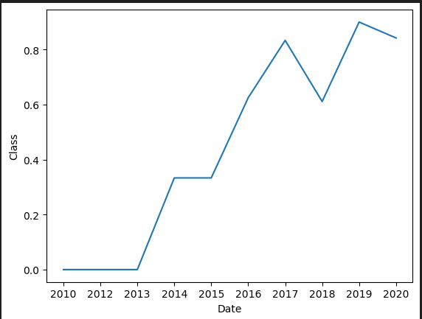
Launch Success Yearly Trend
Line chart of yearly average success rate
Explanations:
You can observe that the sucess rate since 2013 kept increasing till 2020

Slide 24
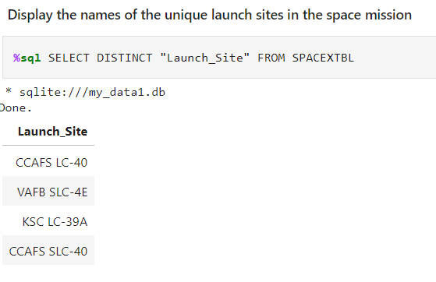
All Launch Site Names
Find the names of the unique launch sites
Explanation:
The SELECT DISTINCT statement is used to return only distinct (different) values.

Slide 25
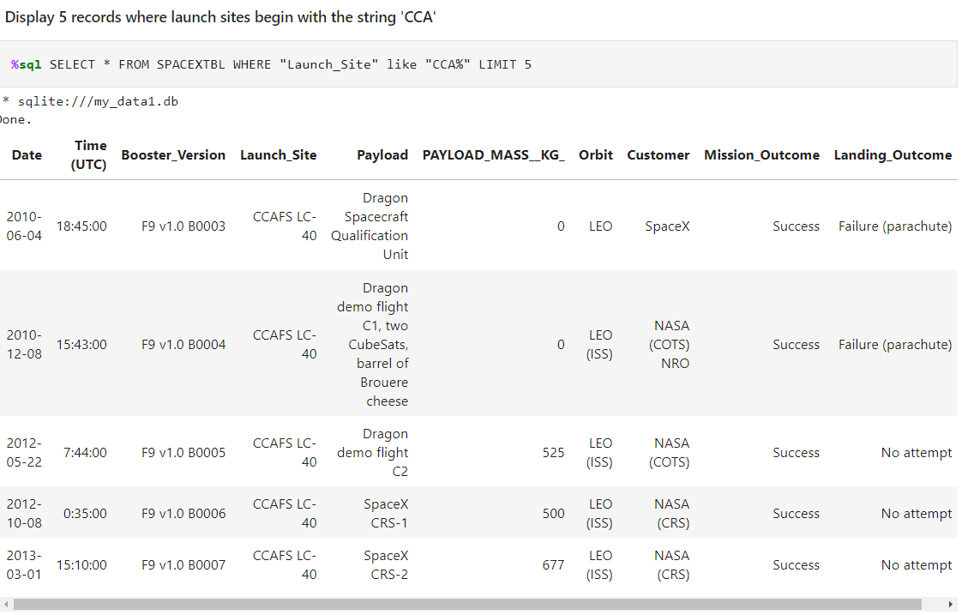
Launch Site Names Begin with 'CCA'
Find 5 records where launch sites begin with `CCA`
Explanation:
The LIKE operator is used in a WHERE clause to search for a specified pattern in a column.
There are two wildcards often used in conjunction with the LIKE operator:
The percent sign % represents zero, one, or multiple characters
The underscore sign _ represents one, single character

Slide 26
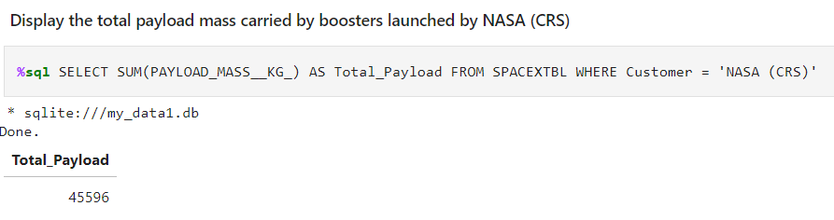
Total Payload Mass
Calculate the total payload carried by boosters from NASA
Explanation:
The SUM() function returns the total sum of a numeric column.
The WHERE clause is used to filter records. It is used to extract only those records that fulfill a specified condition.

Slide 27
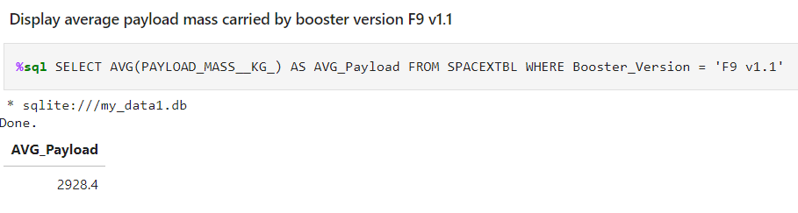
Average Payload Mass by F9 v1.1
Calculate the average payload mass carried by booster version F9 v1.1
Explanation:
The AVG() function returns the average value of a numeric column.

Slide 28
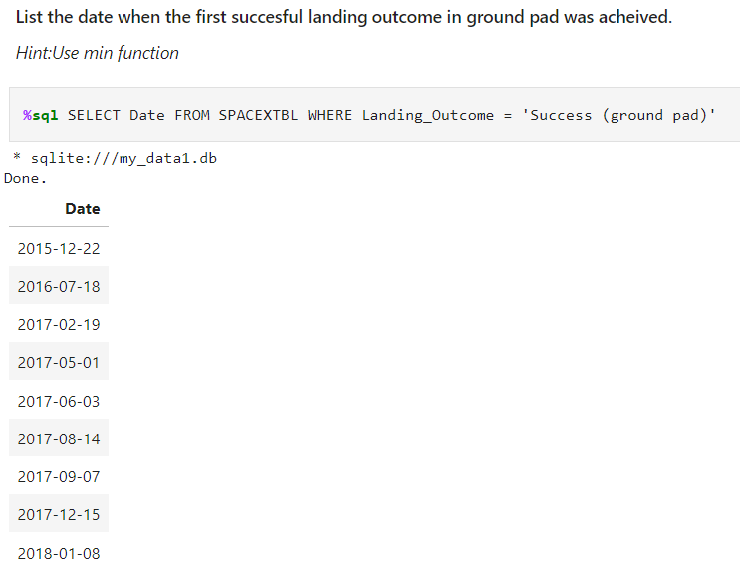
First Successful Ground Landing Date
Find the dates of the first successful landing outcome on ground pad
Explanation:
The answer was achieved listing the dates when the firsts successful landing outcome in ground pad

Slide 29
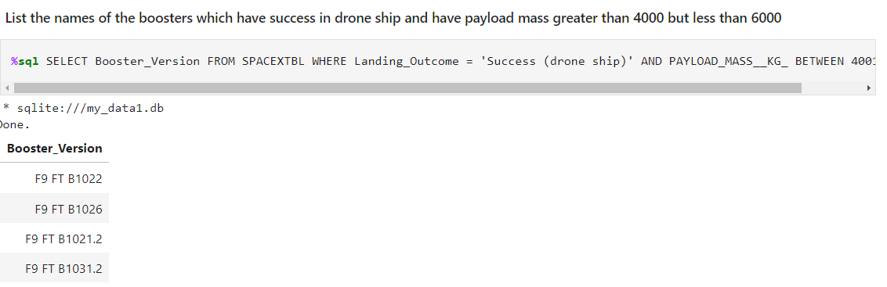
Successful Drone Ship Landing with Payload between 4000 and 6000
List the names of boosters which have successfully landed on drone ship and had payload mass greater than 4000 but less than 6000
Explanation:
The WHERE clause can contain one or many AND operators.
The AND operator is used to filter records based on more than one condition
The BETWEEN operator selects values within a given range. The values can be numbers, text, or dates.
The BETWEEN operator is inclusive: begin and end values are included.

Slide 30
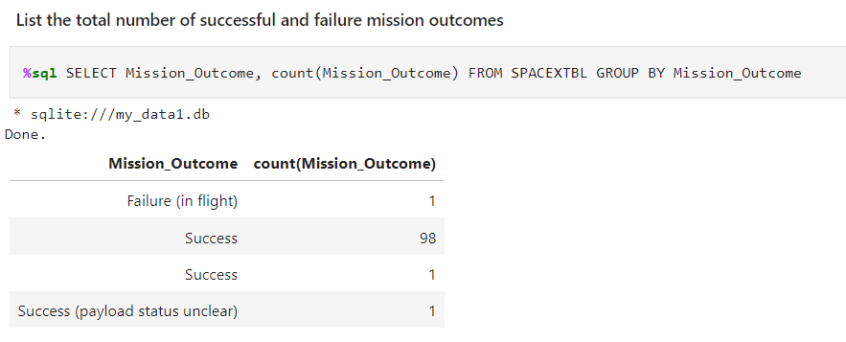
Total Number of Successful and Failure Mission Outcomes
Calculate the total number of successful and failure mission outcomes
Explanation:
The GROUP BY statement groups rows that have the same values into summary rows, like "find the number of customers in each country".
The GROUP BY statement is often used with aggregate functions (COUNT(), MAX(), MIN(), SUM(), AVG()) to group the result-set by one or more columns.

Slide 31
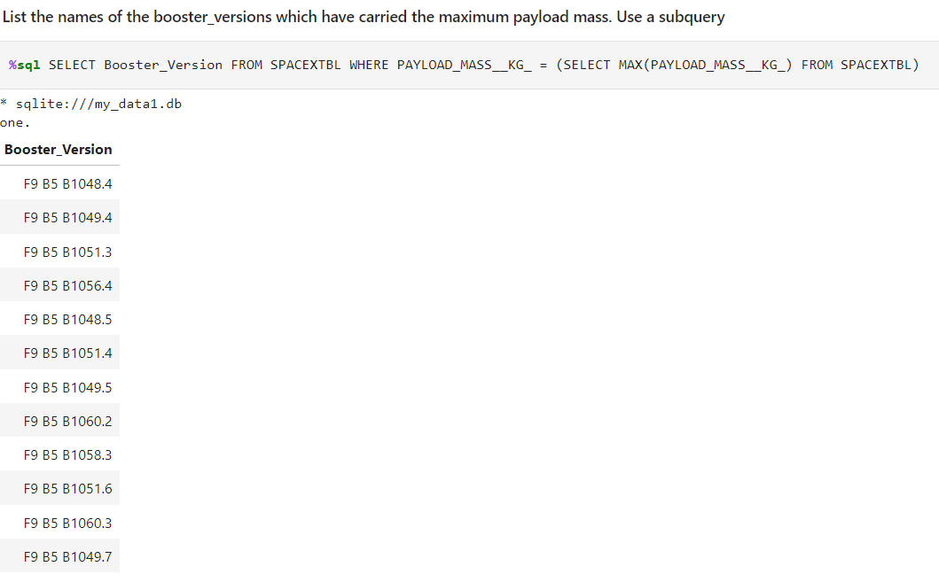
Boosters Carried Maximum Payload
List the names of the booster which have carried the maximum payload mass
Explanation:
Subqueries allow you to nest one query inside another, enabling more complex and efficient data retrieval

Slide 32
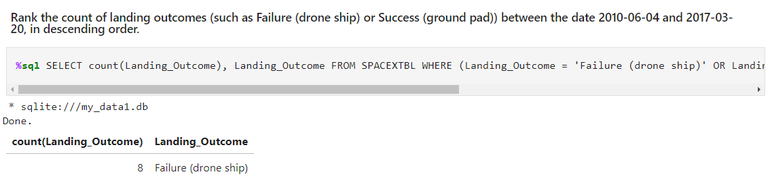
2015 Launch Records
List the failed landing_outcomes in drone ship, their booster versions, and launch site names for in year 2015
Explanation:
The COUNT() function returns the number of rows that matches a specified criterion.

Slide 33
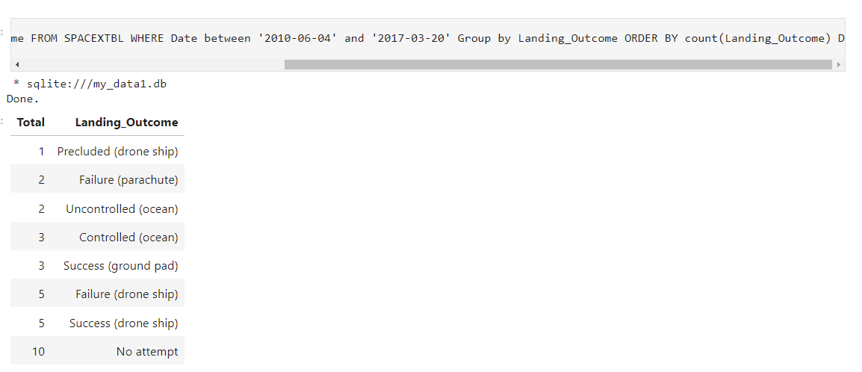
Rank Landing Outcomes Between 2010-06-04 and 2017-03-20
Rank the count of landing outcomes (such as Failure (drone ship) or Success (ground pad)) between the date 2010-06-04 and 2017-03-20, in descending order
Explanation:
The ORDER BY keyword is used to sort the result-set in ascending or descending order.

Slide 34

Section 3

Slide 35
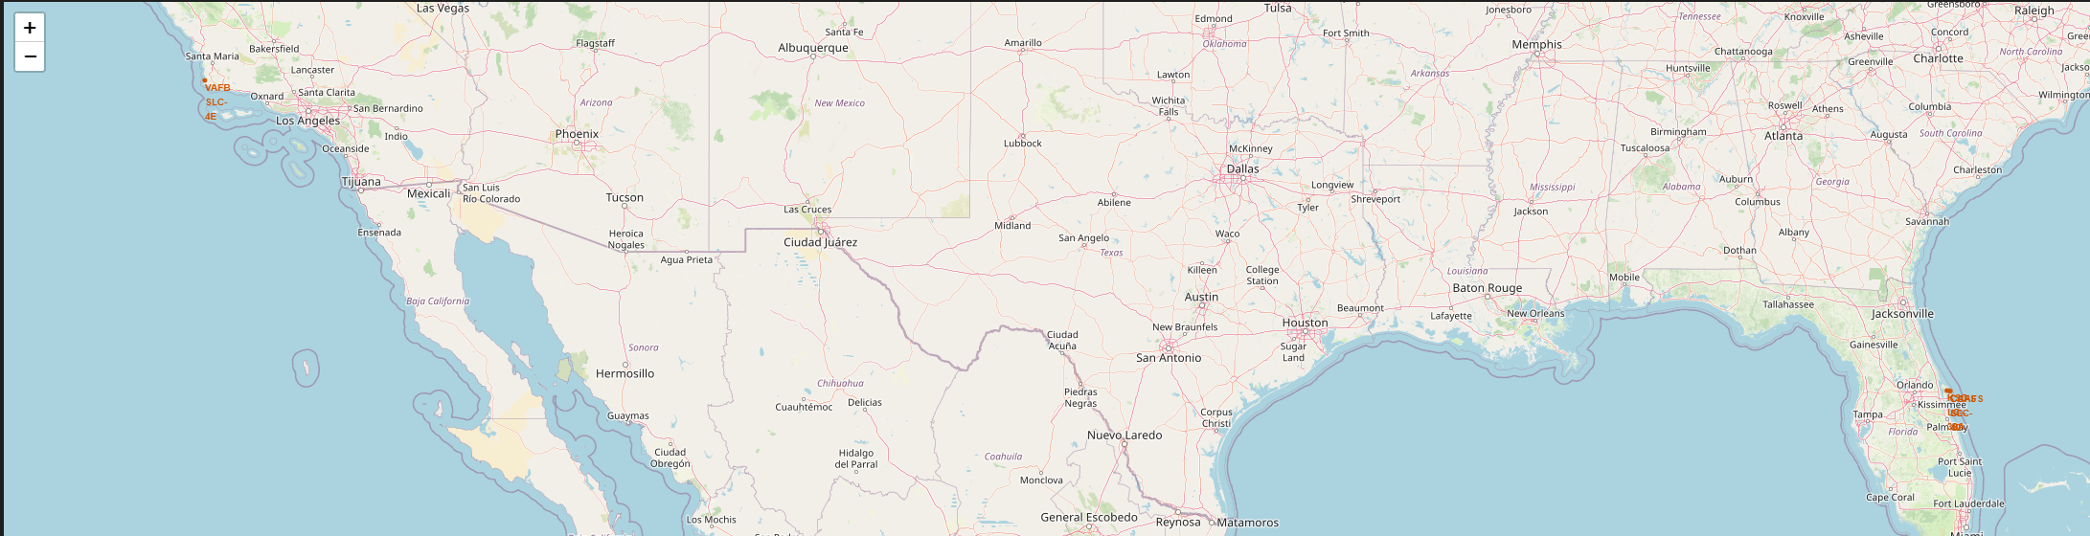
Launch sites
Launch sites are often near the equator because the Earth's rotation speed is fastest there.
Launch sites are located near the coast to minimize the risk of debris affecting populated areas.

Slide 36
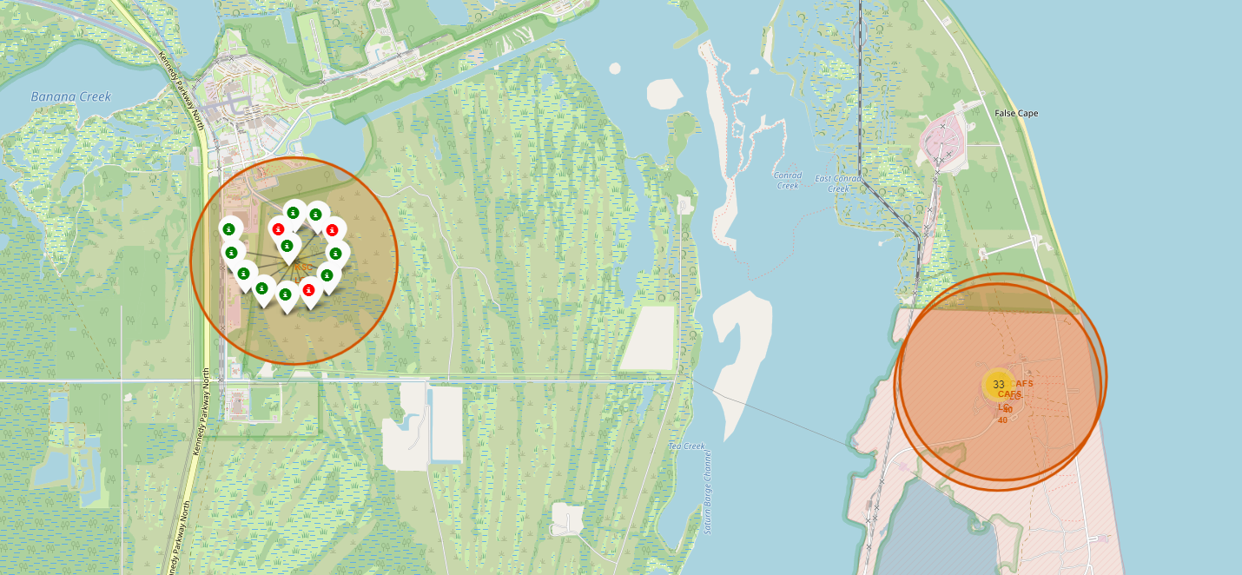
Successful and Failed Launch
Green color for successful launch
Red color for Failes Launch

Slide 37
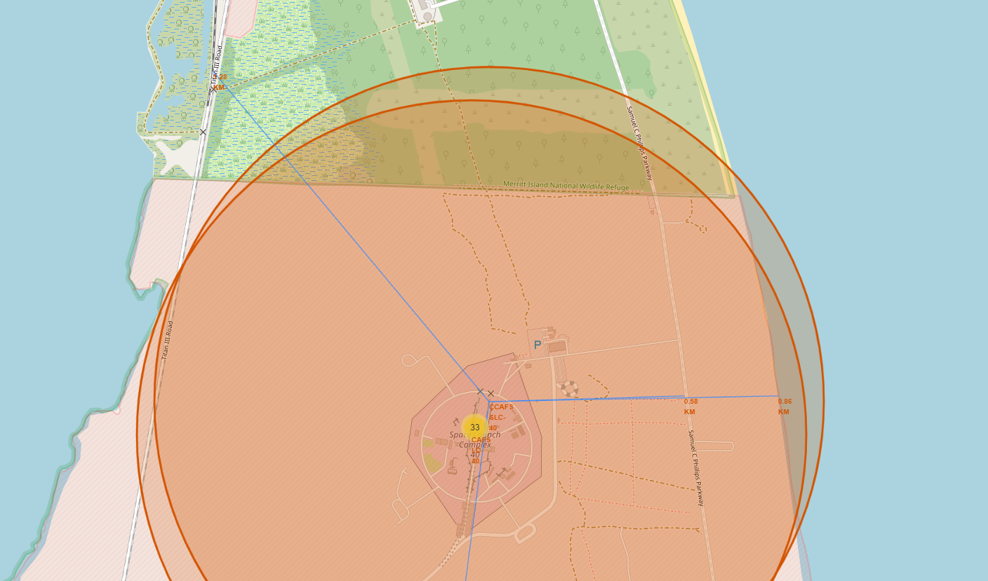
Distances from the launch site
The launch sites is close to coastline and railway

Slide 38

Section 4

Slide 39
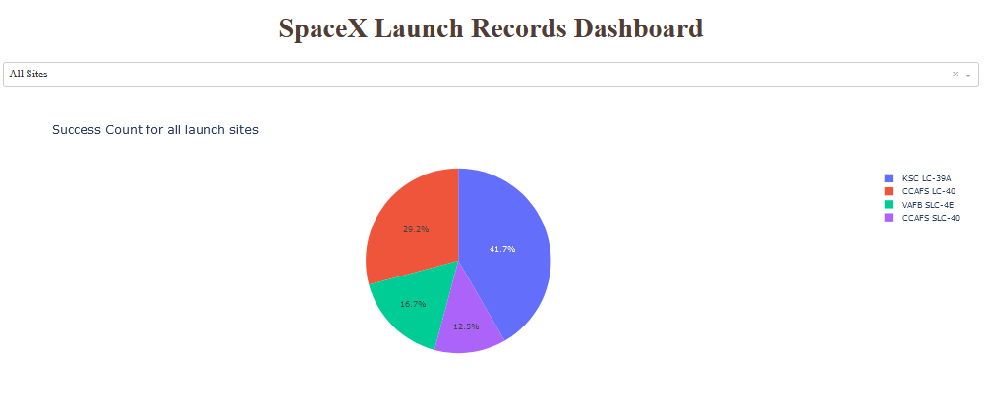
Launch success count for all sites
Explanation:
The KSC LC-39A site has the highest success rate (41.7%), suggesting that it is the most widely used site or has the best track record of successful launches, followed by CCAFS LC-40 with 29.2%.
VAFB SLC-4E and CCAFS SLC-40 have lower representation, with 16.7% and 12.5%, respectively.

Slide 40
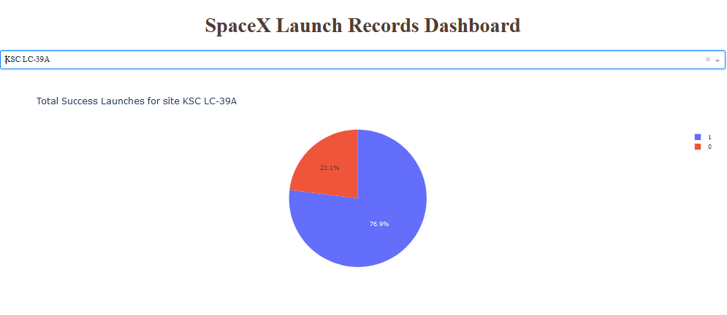
Total Success Launches for site KSC LC-39A
Explanation:
This chart highlights that the KSC LC-39A site has a high success rate, with more than three-quarters of launches successfully completed.
However, the 23.1% failure rate indicates that there is still a significant percentage of launches that were not successful.

Slide 41
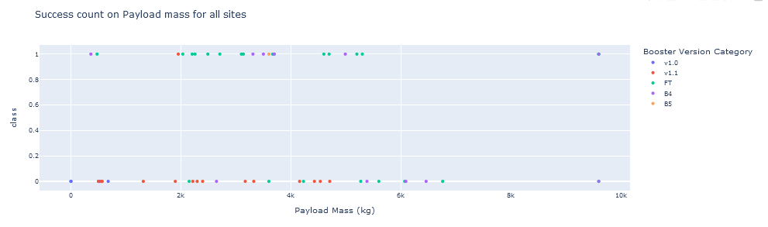
Payload vs. Launch Outcome scatter plot for all sites
Explanation:
The chart show that payloads between 2K and 5K has the highest success rates

Slide 42

Section 5

Slide 43
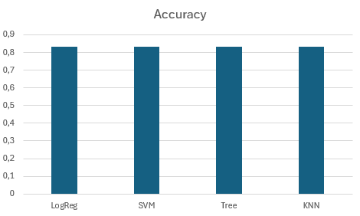
Classification Accuracy
All the model show the same accuracy: 0.833333

Slide 44

Confusion Matrix
Explanation:
According to the matrix, the model correctly classifies 15 of the cases as true positives or negatives.
In the case of erroneous classification, only 3 false positives were detected.

Slide 45
Conclusions
Launch Success: KSC LC-39A launch site has the highest success rate at 41.7%, followed by CCAFS LC-40 at 29.2%. This suggests that KSC LC-39A is either the most used site or has the best track record of successful launches.
Relationship between payload and launch success: Launches with payload mass above 7000 kg were mostly successful. Furthermore, KSC LC-39A has a 100% success rate for payloads below 5000 kg.
Annual Launch Success Trend: The launch success rate has been increasing from 2013 to 2020. This indicates continuous improvement in launch technology and procedures.
Predictive Analysis: The developed classification models showed an accuracy of 83.33%. This suggests that the models are fairly accurate at predicting launch success based on the available data.

Slide 46
Appendix
In this repository you will find various datasets, notebooks, and python code used during the course

Slide 47


